Slide 1
Applying Models of Auditory Processing to
Automatic Speech Recognition:
Promise and Progress
Richard Stern
(with Chanwoo Kim and Yu-Hsiang Chiu)
Department of Electrical and Computer Engineering
and Language Technologies Institute
Carnegie Mellon University
Pittsburgh, Pennsylvania 15213
Telephone: +1 412 268-2535; FAX: +1 412 268-3890
Email: rms@cs.cmu.edu; http://www.ece.cmu.edu/~rms
Universidad de Zaragoza
May 28, 2014

Slide 2
Introduction – auditory processing and automatic speech recognition
I was originally trained in auditory perception, and my original work was in binaural hearing
Over the past 20-25 years, I have been spending the bulk of my time trying to improve the accuracy of automatic speech recognition systems in difficult acoustical environments
In this talk I would like to discuss some of the ways in my group (and many others) have been attempting to apply knowledge of auditory perception to improve ASR accuracy
  Comment: approaches can be more or less faithful to physiology and psychophysics

Slide 3
The big questions ….
How can knowledge of auditory physiology and perception improve speech recognition accuracy?
Can speech recognition results tell us anything we don’t already know about auditory processing?
What aspects of the processing are most valuable for robust feature extraction?

Slide 4
So what I will do is ….
Briefly review some of the major physiological and psychophysical results that motivate the models
Briefly review and discuss the major “classical” auditory models of the 1980s
  Seneff, Lyon, and Ghitza
Review some of the major new trends in today’s models
Talk about some representative issues that have driven work as of late at CMU and what we have learned from them

Slide 5
Basic auditory anatomy
Structures involved in auditory processing:

Slide 6
Central auditory pathways
There is a lot going on!
For the most part, we only consider the response of the auditory nerve
  It is in series with everything else

Slide 7
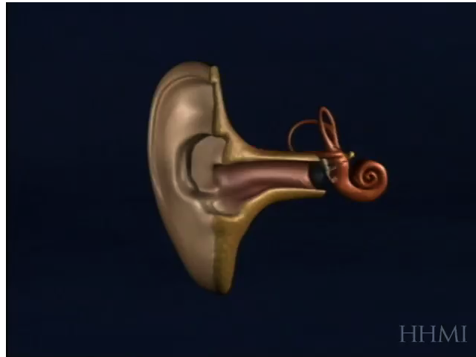
Excitation along the basilar membrane

Slide 8
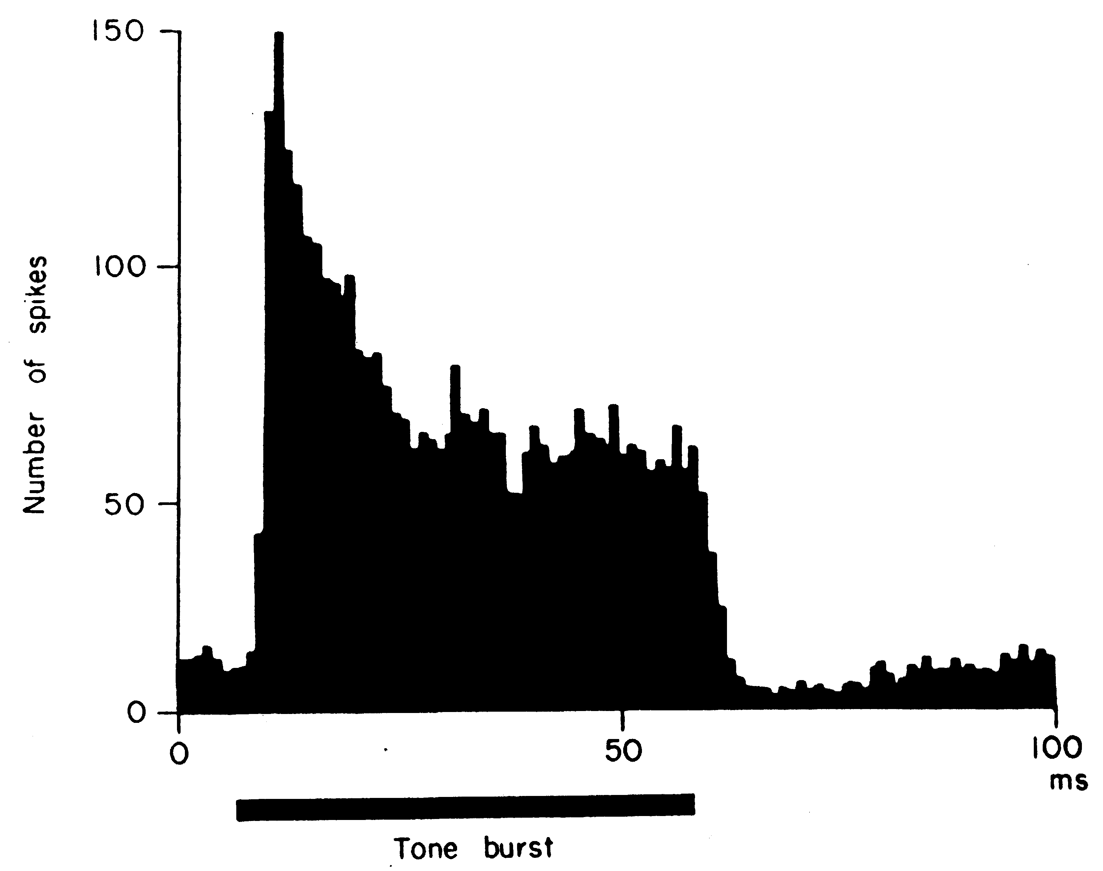
Transient response of auditory-nerve fibers
Histograms of response to tone bursts (Kiang et al., 1965):
Comment: Onsets and offsets produce overshoot

Slide 9
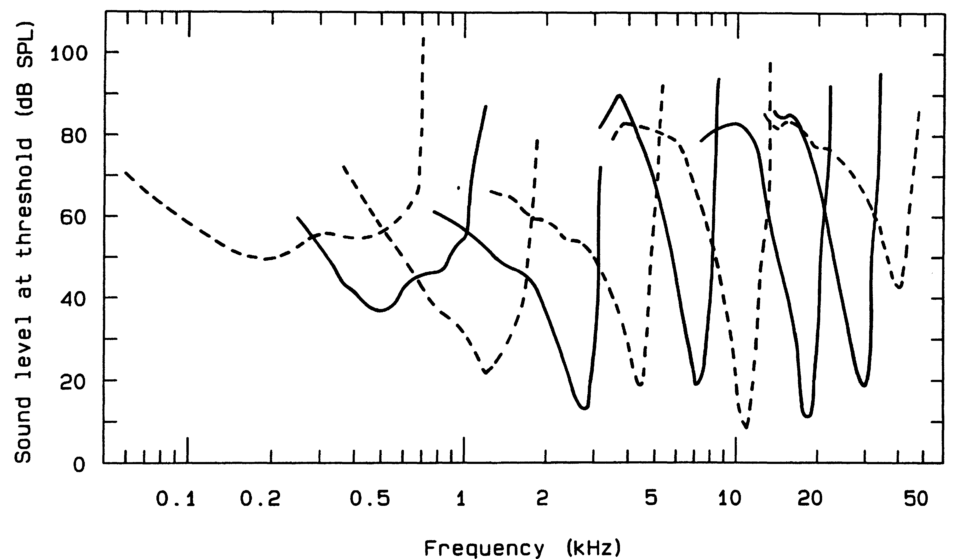
Frequency response of auditory-nerve fibers: tuning curves
Threshold level for auditory-nerve response to tones:
Note dependence of bandwidth on center frequency and asymmetry of response

Slide 10
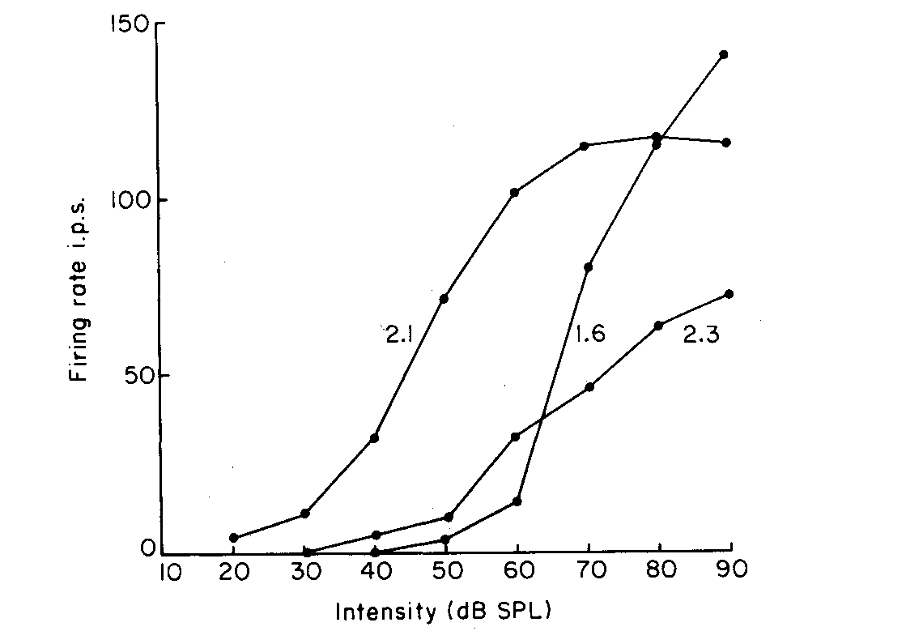
Typical response of auditory-nerve fibers as a function of stimulus level
Typical response of auditory-nerve fibers to tones as a function of intensity:
Comment:
  Saturation and limited dynamic range

Slide 11
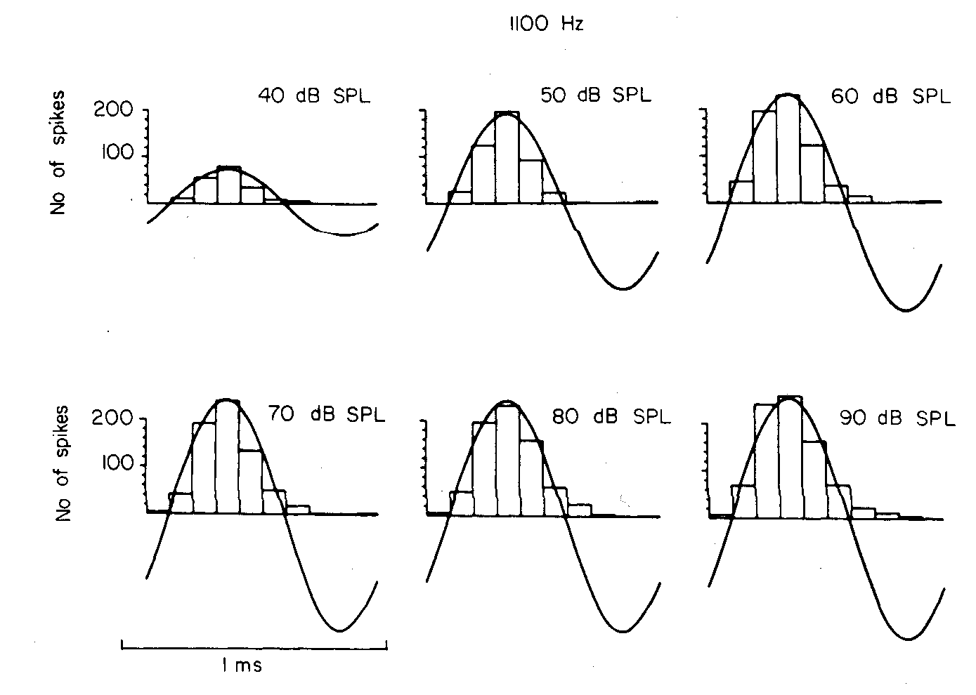
Synchronized auditory-nerve response to low-frequency tones
Comment: response remains synchronized over a wide range of intensities

Slide 12
Comments on synchronized auditory response
Nerve fibers synchronize to fine structure at “low” frequencies, signal envelopes at high frequencies
Synchrony clearly important for auditory localization
Synchrony could be important for monaural processing of complex signals as well

Slide 13
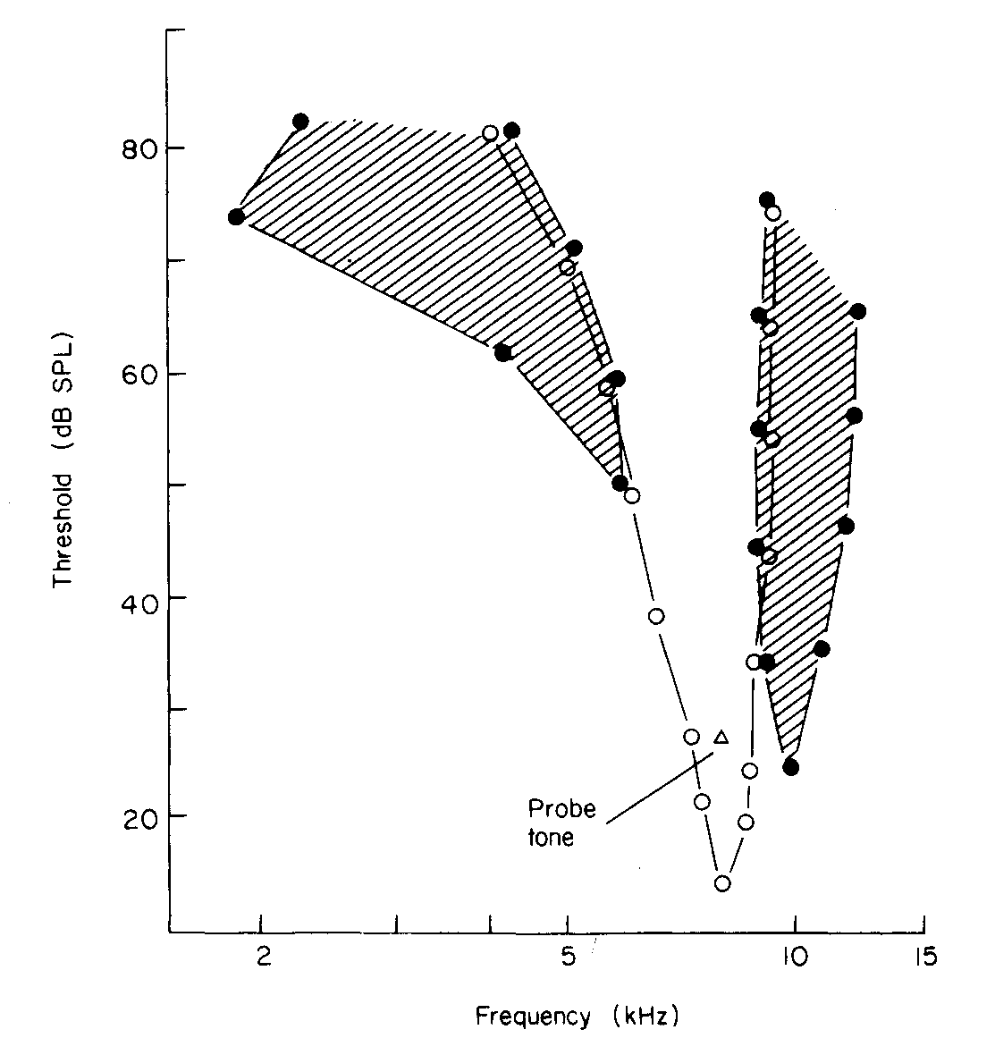
Lateral suppression in auditory processing
Auditory-nerve response to pairs of tones:
Comment: Lateral suppression enhances local contrast in frequency

Slide 14
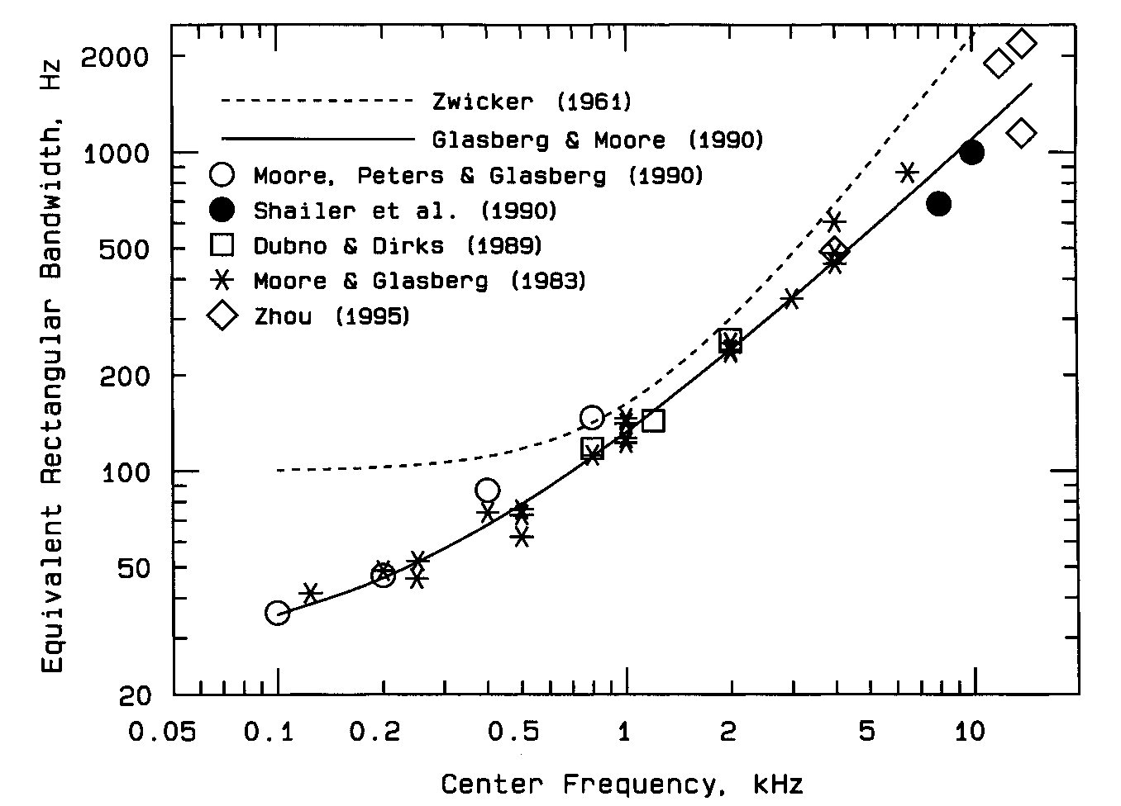
Auditory frequency selectivity: critical bands
Measurements of psychophysical filter bandwidth by various methods:
Comments:
  Bandwidth increases with center frequency
  Solid curve is “Equivalent Rectangular Bandwidth” (ERB)

Slide 15
Three perceptual auditory frequency scales
Bark scale:
(DE)
Mel scale:
(USA)
ERB scale:
(UK)

Slide 16
Comparison of normalized perceptual frequency scales
Bark scale (in blue), Mel scale (in red), and ERB scale (in green):

Slide 17

Forward and backward masking
Masking can have an effect even if target and masker are not simultaneously presented
Forward masking - masking precedes target
Backward masking - target precedes masker
Examples:

Slide 18
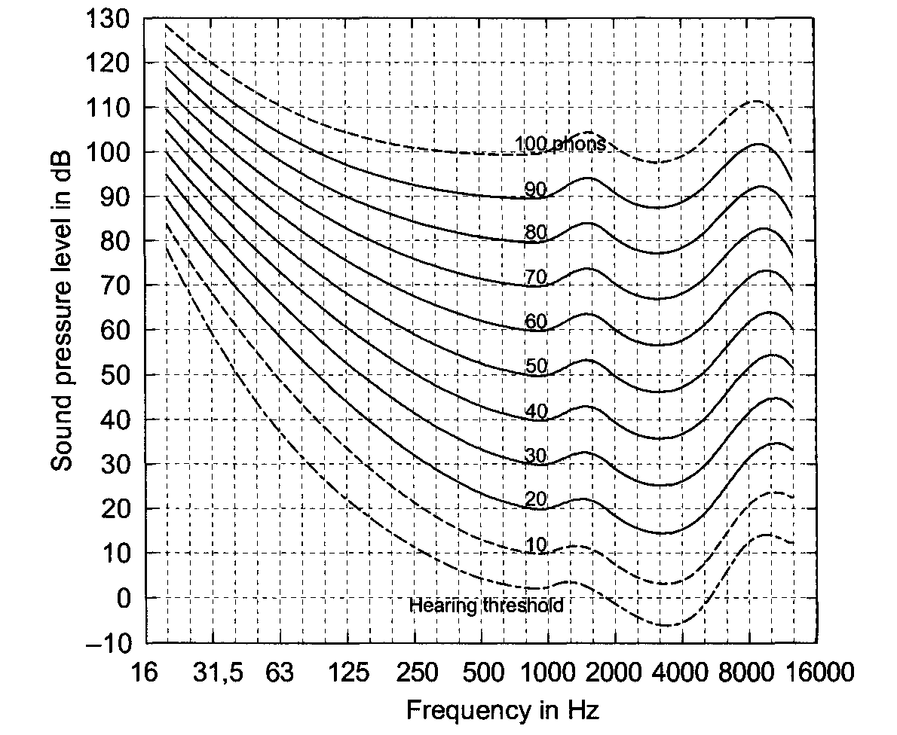
The loudness of sounds
Equal loudness contours (Fletcher-Munson curves):

Slide 19
Summary of basic auditory physiology and perception
Major monaural physiological attributes:
  Frequency analysis in parallel channels
  Preservation of temporal fine structure
  Limited dynamic range in individual channels
  Enhancement of temporal contrast (at onsets and offsets)
  Enhancement of spectral contrast (at adjacent frequencies)
Most major physiological attributes have psychophysical correlates
Most physiological and psychophysical effects are not preserved in conventional representations for speech recognition

Slide 20
Default signal processing:
Mel frequency cepstral coefficients (MFCCs)
Comment: 20-ms time slices are modeled by smoothed spectra,
with attention paid to auditory frequency selectivity

Slide 21
What the speech recognizer sees ….
An original spectrogram: Spectrum “recovered” from MFCC:

Slide 22
Comments on the MFCC representation
It’s very “blurry” compared to a wideband spectrogram!
Aspects of auditory processing represented:
  Frequency selectivity and spectral bandwidth (but using a constant analysis window duration!)
    Wavelet schemes exploit time-frequency resolution better
  Nonlinear amplitude response
Aspects of auditory processing NOT represented:
  Detailed timing structure
  Lateral suppression
  Enhancement of temporal contrast
  Other auditory nonlinearities

Slide 23
Auditory models in the 1980s: the Seneff model
Overall model:
Detail of Stage II:
  An early well-known auditory model
  In addition to mean rate, used “Generalized Synchrony Detector” to extract synchrony

Slide 24
Auditory models in the 1980s:
Ghitza’s EIH model
  Estimated timing information from ensembles of zero crossings with different thresholds

Slide 25
Auditory models in the 1980s:
Lyon’s auditory model
Single stage of the Lyon auditory model:
  Lyon model included nonlinear compression, lateral suppression, temporal effects
  Also added correlograms (autocorrelation and crosscorrelation of model outputs)

Slide 26
Perceptual Linear Prediction (Hermansky): pragmatic application of auditory principles
The PLP algorithm is a pragmatic approach to model the auditory periphery
Includes:
  Resampling for frequency warping
  Limited frequency resolution
  Pre-emphasis according to threshold of hearing
  Amplitude compression
  Smoothing using linear prediction
Computational complexity similar to LPCC, MFCC
Sometimes provides better recognition accuracy

Slide 27
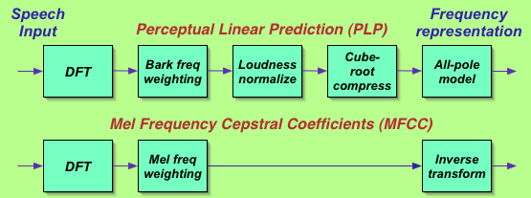
PLP versus MFCC processing
Comments:
  Extra blocks in PLP motivated by additional physiological phenomena
  Implementation differences, even in “common blocks”

Slide 28
Auditory modeling was expensive:
Computational complexity of Seneff model
Number of multiplications per ms of speech (from Ohshima and Stern, 1994):

Slide 29
Summary: early auditory models
The models developed in the 1980s included:
  “Realistic” auditory filtering
  “Realistic” auditory nonlnearity
  Synchrony extraction
  Lateral suppression
  Higher order processing through auto-correlation and cross-correlation
Every system developer had his or her own idea of what was important

Slide 30
Evaluation of early auditory models
(Ohshima and Stern, 1994)
Not much quantitative evaluation actually performed
General trends of results:
  Physiological processing did not help much (if at all) for clean speech
  More substantial improvements observed for degraded input
  Benefits generally do not exceed what could be achieved with more prosaic approaches (e.g. CDCN/VTS in our case).

Slide 31
Other reasons why work on auditory models subsided in the late 1980s …
Failure to obtain a good statistical match between characteristics of features and speech recognition system
  Ameliorated by subsequent development of continuous HMMs
More pressing need to solve other basic speech recognition problems

Slide 32
Renaissance in the 1990s!
By the late 1990s, physiologically-motivated and perceptually-motivated approaches to signal processing began to flourish
Some major new trends ….
Computation no longer such a limiting factor
Serious attention to temporal evolution
Attention to reverberation
Binaural processing
More effective and mature approaches to information fusion

Slide 33
Peripheral auditory modeling at CMU 2004–now
Foci of activities:
  Representing synchrony
  The shape of the rate-intensity function
  Revisiting analysis duration
  Revisiting frequency resolution
  Onset enhancement
  Modulation filtering
  Binaural and “polyaural” techniques
  Auditory scene analysis: common frequency modulation

Slide 34
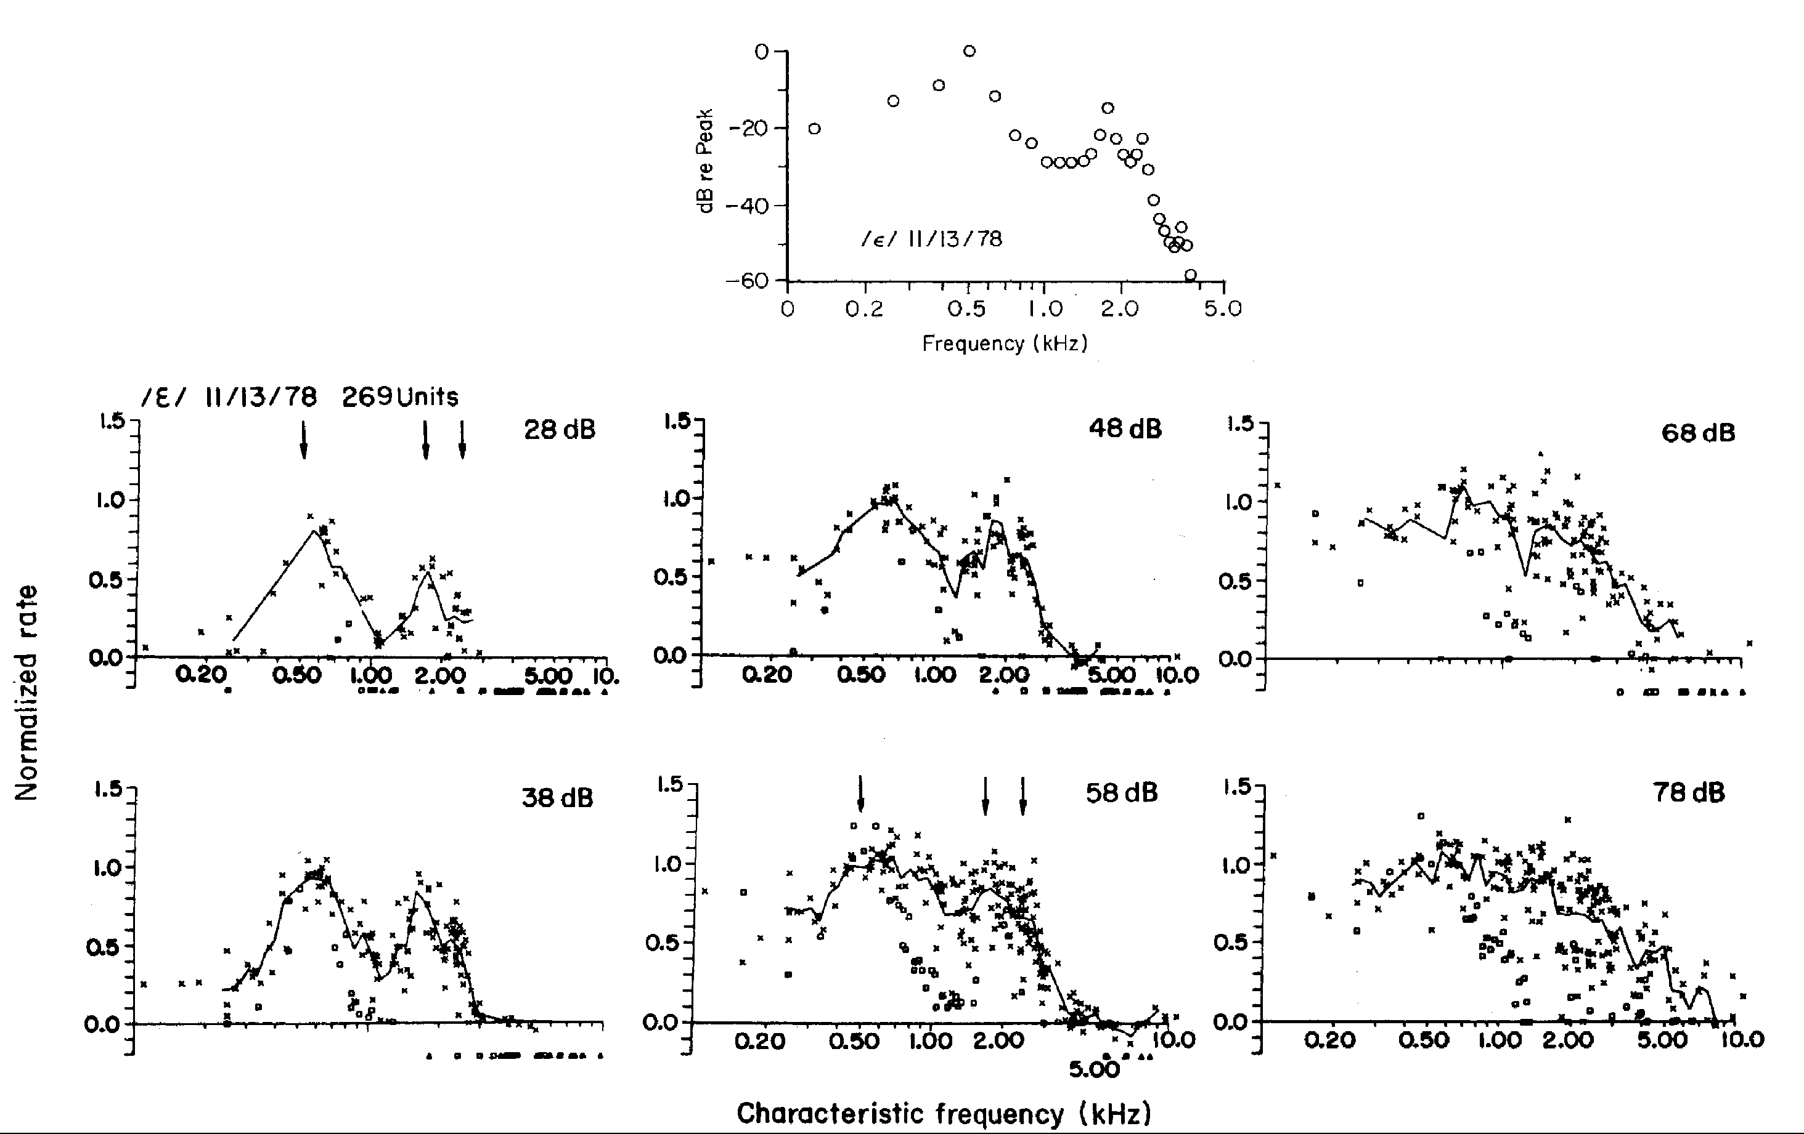
Speech representation using mean rate
Representation of vowels by Young and Sachs using mean rate:
Mean rate representation does not preserve spectral information

Slide 35
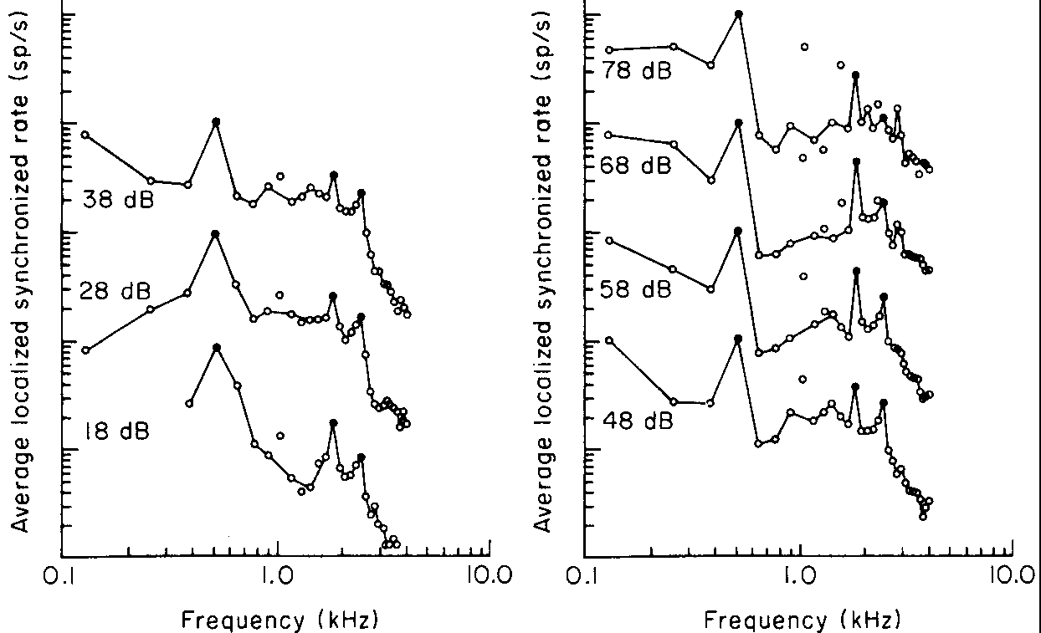
Speech representation using average localized synchrony rate
Representation of vowels by Young and Sachs using ALSR:

Slide 36
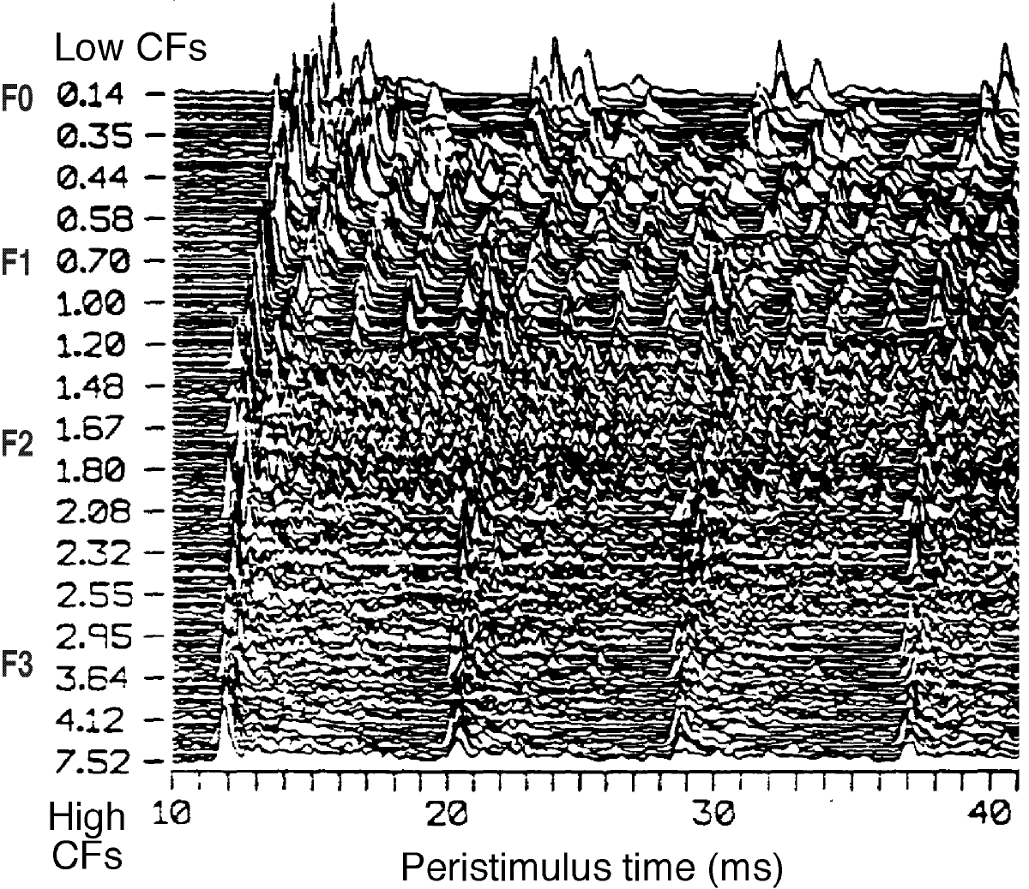
The importance of timing information
Re-analysis of Young-Sachs data by Secker-Walker and Searle:
Temporal processing captures dominant formants in a spectral region

Slide 37
Physiologically-motivated signal processing: the Zhang-Carney model of the periphery
We used the “synapse output” as the basis for further processing

Slide 38
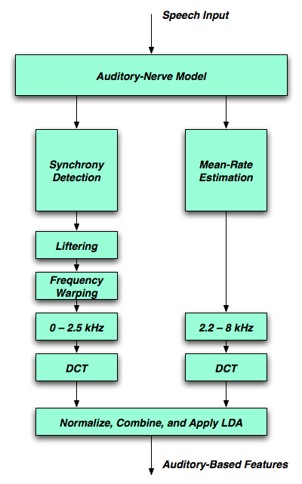
Physiologically-motivated signal processing: synchrony and mean-rate detection (Kim/Chiu ‘06)
Synchrony response is smeared across frequency to remove pitch effects
Higher frequencies represented by mean rate of firing
Synchrony and mean rate combined additively
Much more processing than MFCCs

Slide 39
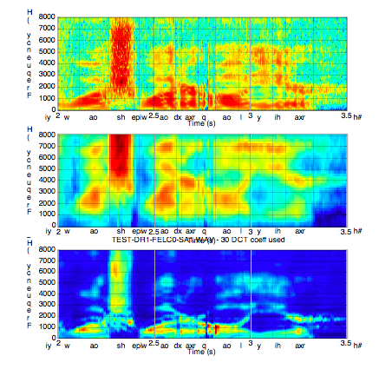
Comparing auditory processing with cepstral analysis: clean speech
Original
spectrogram
MFCC
reconstruction
Auditory
analysis

Slide 40
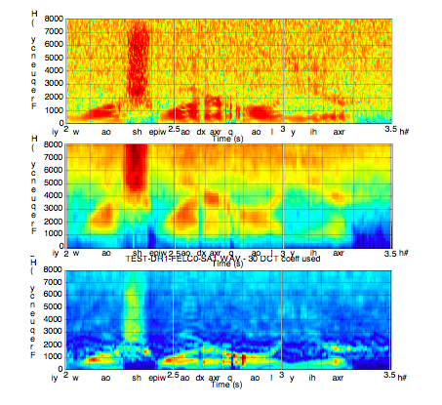
Comparing auditory processing with cepstral analysis: 20-dB SNR

Slide 41
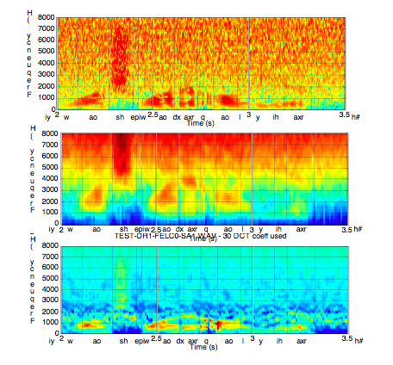
Comparing auditory processing with cepstral analysis: 10-dB SNR

Slide 42
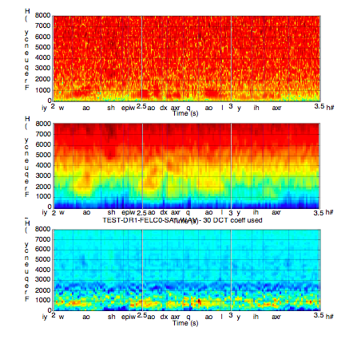
Comparing auditory processing with cepstral analysis: 0-dB SNR

Slide 43
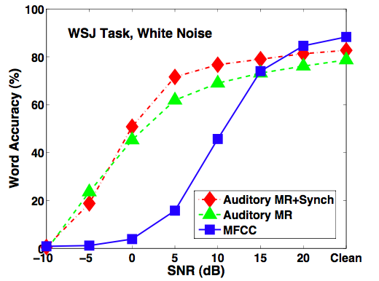
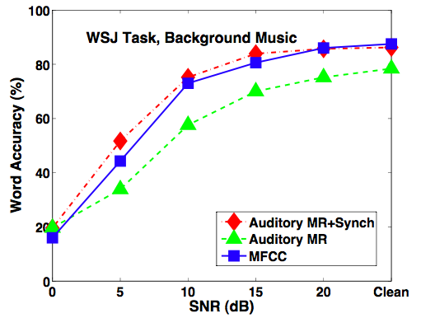
Auditory processing is more effective than MFCCs at low SNRs, especially in white noise
Curves are shifted by 10-15 dB (greater improvement than obtained with VTS or CDCN)
[Results from Kim et al., Interspeech 2006]
Accuracy in background noise: Accuracy in background music:

Slide 44
Do auditory models really need to be so complex?
Model of Zhang et al. 2001: A much simpler model:

Slide 45
Comparing simple and complex auditory models
Comparing MFCC processing, a trivial (filter–rectify–compress) auditory model, and the full Carney-Zhang model (Chiu 2006):

Slide 46
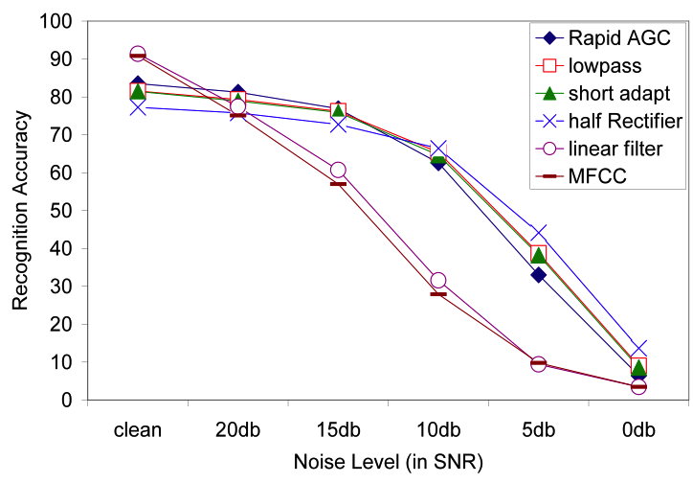
The nonlinearity seems to be the most important attribute of the Seneff model (Chiu ‘08)

Slide 47
Why the nonlinearity seems to help …

Slide 48
Impact of auditory nonlinearity (Chiu)
Learned nonlinearity
Baseline nonlinearity
MFCC

Slide 49
The nonlinearity in PNCC processing (Kim)

Slide 50
Frequency resolution
Examined several types of frequency resolution
  MFCC triangular filters
  Gammatone filter shapes
  Truncated Gammatone filter shapes
Most results do not depend greatly on filter shape
Some sort of frequency integration is helpful when frequency-based selection algorithms are used

Slide 51
Analysis window duration (Kim)
Typical analysis window duration for speech recognition is ~25-35 ms
Optimal analysis window duration for estimation of environmental parameters is ~75-120 ms
Best systems measure environmental parameters (including voice activity detection over a longer time interval but apply results to a short-duration analysis frame

Slide 52
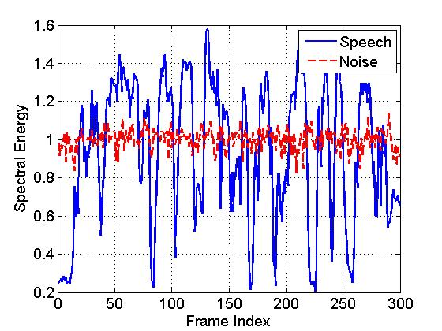
Temporal Speech Properties: modulation filtering
Output of speech and noise segments from 14th Mel filter (1050 Hz)
Speech segment exhibits
greater fluctuations

Slide 53
Nonlinear noise processing
Use nonlinear cepstral highpass filtering to pass speech but not noise
Why nonlinear?
  Need to keep results positive because we are dealing with manipulations of signal power

Slide 54
Asymmetric lowpass filtering (Kim, 2010)
Overview of processing:
  Assume that noise components vary slowly compared to speech components
  Obtain a running estimate of noise level in each channel using nonlinear processing
  Subtract estimated noise level from speech
An example:
Note: Asymmetric highpass filtering is obtained by subtracting the lowpass filter output from the input

Slide 55
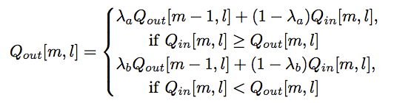
Implementing asymmetric lowpass filtering
Basic equation: Dependence on
parameter values:

Slide 56
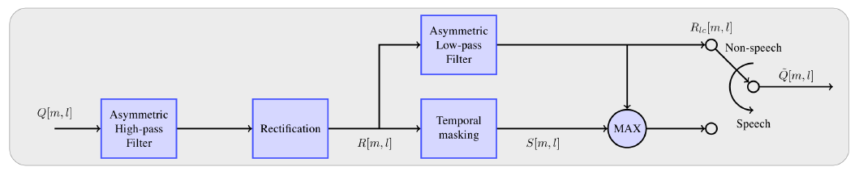
Block diagram of noise processing using asymmetric filters
Speech-nonspeech partitions are obtained based on a simple threshold test
Asymmetric highpass filtering is always applied; asymmetric lowpass filtering is applied only to non-speech segments

Slide 57
PNCC processing (Kim and Stern, 2010,2014)
A pragmatic implementation of a number of the principles described:
  Gammatone filterbanks
  Nonlinearity shaped to follow auditory processing
  “Medium-time” environmental compensation using nonlinearity cepstral highpass filtering in each channel
  Enhancement of envelope onsets
  Computationally efficient implementation

Slide 58
An integrated front end: power-normalized cepstral coefficients (PNCC, Kim ‘10)

Slide 59
An integrated front end: power-normalized cepstral coefficients (PNCC, Kim ‘10)

Slide 60
An integrated front end: power-normalized cepstral coefficients (PNCC, Kim ‘10)

Slide 61
Computational complexity of front ends

Slide 62
Performance of PNCC in white noise (RM)

Slide 63
Performance of PNCC in white noise (WSJ)

Slide 64
Performance of PNCC in background music

Slide 65
Performance of PNCC in reverberation

Slide 66
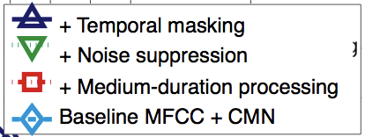
Contributions of PNCC components: white noise (WSJ)
+ Temporal masking
+ Noise suppression
+ Medium-duration processing
Baseline MFCC + CMN
+ Temporal masking
+ Noise protection
+ Medium-time time/freq anal
Baseline MFCC with CMN

Slide 67
Contributions of PNCC components: background music (WSJ)
+ Temporal masking
+ Noise suppression
+ Medium-duration processing
Baseline MFCC + CMN
+ Temporal masking
+ Noise protection
+ Medium-time time/freq anal
Baseline MFCC with CMN

Slide 68
Contributions of PNCC components: reverberation (WSJ)
+ Temporal masking
+ Noise suppression
+ Medium-duration processing
Baseline MFCC + CMN
+ Temporal masking
+ Noise protection
+ Medium-time time/freq anal
Baseline MFCC with CMN

Slide 69
Effects of onset enhancement/temporal masking (SSF processing, Kim ‘10)

Slide 70
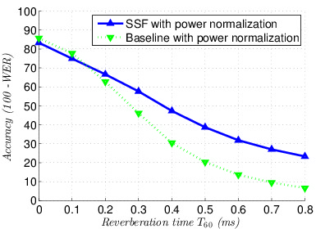
PNCC and SSF @Google

Slide 71
Summary … so what matters?
Knowledge of the auditory system can certainly improve ASR accuracy:
  Use of synchrony
  Consideration of rate-intensity function
  Onset enhancement
  Nonlinear modulation filtering
  Selective reconstruction
  Consideration of processes mediating auditory scene analysis

Slide 72
Summary
PNCC processing includes
  More effective nonlinearity
  Parameter estimation for noise compensation and analysis based on longer analysis time and frequency spread
  Efficient noise compensation based on modulation filtering
  Onset enhancement
  Computationally-efficient implementation
Not considered yet …
  Synchrony representation
  Lateral suppression

